Slide 1
7. HTML: Form I
Presented by Krystal Educational Platform

Slide 2
Contents
7.1 Revise
7.2 What is form?
7.3 Input
7.4 Other input methods
7.5 Exercise

Slide 3
7.1 Revise

Slide 4
7.1 Revise
Can you name any multimedia?
And their tag & attributes?
How to embed a Google Map?
Which tags help us to draw a star?
Notes:
Open T6 ppt for ans

Slide 5
7.2 What is form?

Slide 6

7.2 What is form?
A container for <input>
e.g. text fields, checkboxes, radio buttons, submit buttons
Use for collecting user input
User input(s) is sent to a server for processing

Slide 7
7.2.1 Form: Common attributes
id
Identifies an unique id so that the form can be recognize in commands (e.g. JS, Python)
action
Specifies where to send the form data
E.g. PHP file (Commonly used), other HTML (with Python supported)
method
Get (default)
Post: Safer, can send more data
Notes:
Won’t teach submission of form, so won’t talk about action & method much

Slide 8
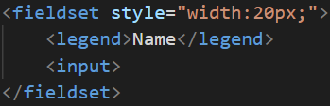

7.2.2 Form layout: <fieldset>
To identify different groups of input
Title of the <fieldset>: <legend>

Slide 9
7.3 Input
Notes:
https://www.w3schools.com/tags/tag_label.asp
https://developer.mozilla.org/en-US/docs/Web/HTML/Element/label
The <label> HTML element represents a caption for an item in a user interface.
Tip: The for attribute of <label> must be equal to the id attribute of the related element to bind them together.
1. To associate the <label> with an <input> element, you need to give the <input> an id attribute. The <label> then needs a for attribute whose value is the same as the input's id.
2. Alternatively, you can nest the <input> directly inside the <label>, in which case the for and id attributes are not needed because the association is implicit:

Slide 10

7.3 Input: <input>
The most common form element
Attribute (commonly used)
type
Default: text
id, name
placeholder
A hint for expected value
value
Change default input
Use a label to tell users what the input is for

Slide 11



7.3.1 type=“button”
Use value attribute to change the default value

Slide 12

7.3.2 type=“checkbox”
Used for multiple selection
Default: Not checked
To change the default:

Slide 13

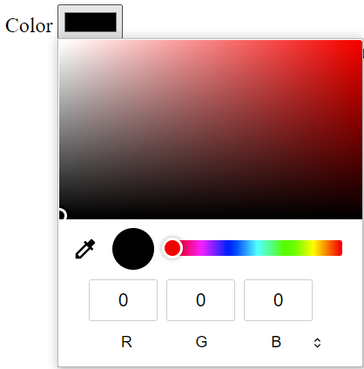
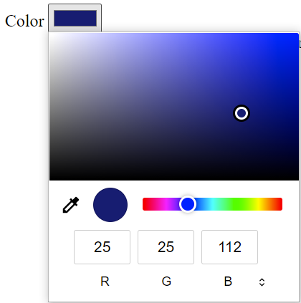
7.3.3 type=“color”
Default: Black
To change the default, enter other color’s HEX:
Notes:
The value of an <input> element of type color is always a string which contains a 7-character string specifying an RGB color in hexadecimal format.

Slide 14
7.3.3 type=“color”
For more HTML color codes:
https://htmlcolorcodes.com/

Slide 15

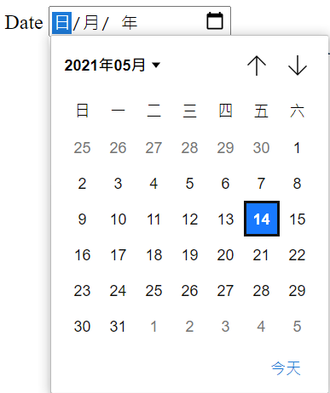

7.3.4 type=“date”
To change the default:
Notes:
Type / Select to change

Slide 16
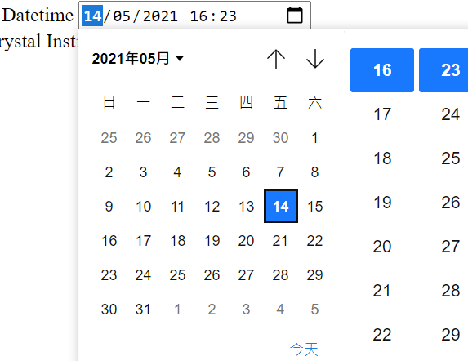
7.3.5 type=“datetime-local”

Slide 17

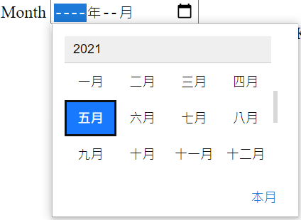

7.3.6 type=“month”
To change the default:

Slide 18

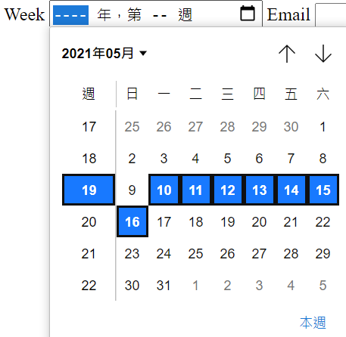
7.3.7 type=“week”

Slide 19

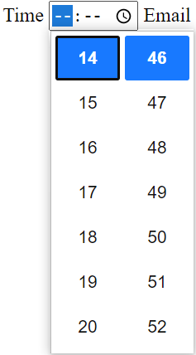

7.3.8 type=“time”
To change the default:

Slide 20


7.3.9 type=“file”

Slide 21
7.3.10 type=“hidden”
A hidden field will NOT be displayed, but the value will be sent when submitted

Slide 22



7.3.11 type=“number”
Input other than numbers is NOT allowed
To change the range:
To change the default value:
Notes:
Type / Click the buttons to change the no.

Slide 23



7.3.12 type=“range”
Default range: 0-100
Default: 50
To change the range:
To change the default value:

Slide 24



7.3.13 type=“search”
Defines an input as search input
Details will be mentioned in next lesson
Delete button

Slide 25


7.3.14 type=“radio”
Used for SINGLE selection
To set default selection:
Notes:
https://www.w3schools.com/tags/att_input_type_radio.asp
Radio buttons presented in radio groups (a collection of radio buttons describing a set of related options). Only one radio button in a group can be selected at the same time.
Note: The radio group must have share the same name (the value of the name attribute) to be treated as a group. Once the radio group is created, selecting any radio button in that group automatically deselects any other selected radio button in the same group.

Slide 26

7.3.15 type=“tel”
Indicates that the input is phone no.
Nothing special, just displays as a text field

Slide 27

7.3.16 type=“reset”
Click to reset all inputs in the form

Slide 28

7.3.17 type=“submit”
To submit the form
There can only be ONE submit input in a form

Slide 29

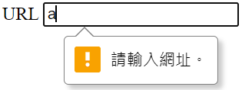


7.3.18 type=“url”
Only input that starts with http:// OR https:// is allowed
E.g.

Slide 30


7.3.19 type=“email”
Email type supports validation in some browsers

Slide 31
7.4 Other input methods

Slide 32
7.4 Other input methods
Text area: <textarea>
Dropdown: <select>, <optgroup>, <option>

Slide 33
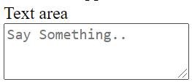
7.4.1 Text area:<textarea>
Adjustable text area
Can skip lines
Adjust the input size by dragging it

Slide 34
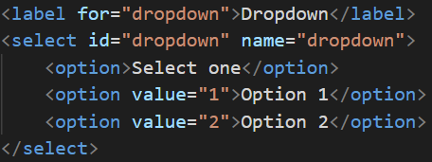

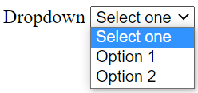
7.4.2 Dropdown: <select>
To change the default:

Slide 35
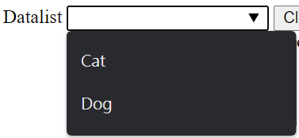
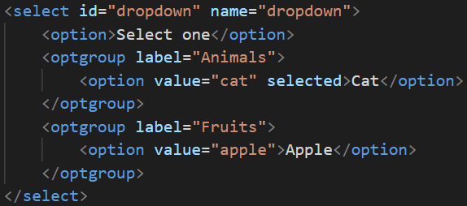
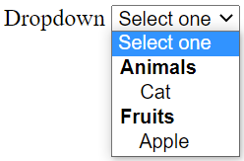
7.4.2 Dropdown: <select>
Option group: <optgroup>

Slide 36
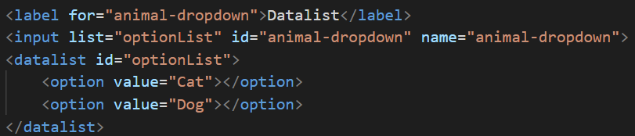
7.4.3 Dropdown: <datalist>
Use <datalist> when you have lots of options

Slide 37
7.5 Exercise

Slide 38
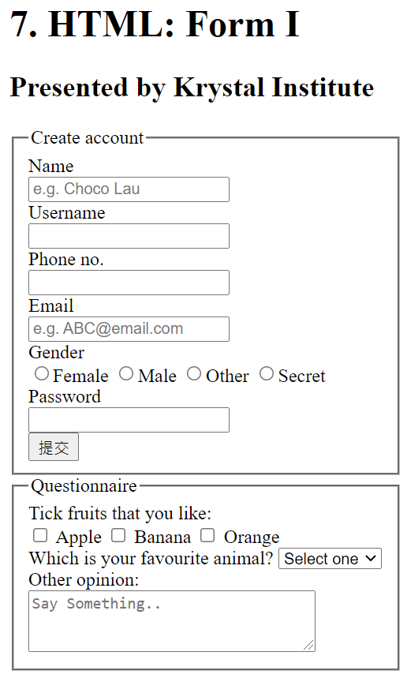
7.5 Exercise
Notes:
Demonstrate the sample website

Slide 39
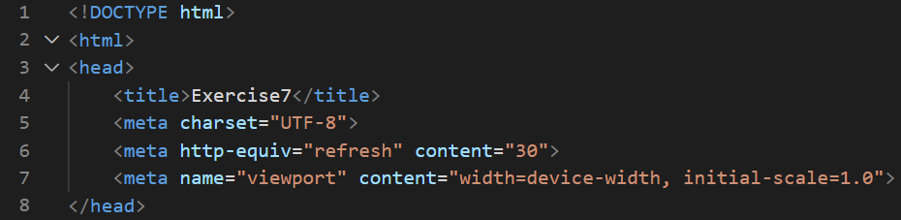
7.5 Exercise: Suggested answer
Notes:
Demonstrate the sample website

Slide 40
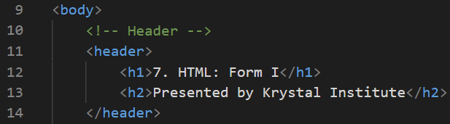
7.5 Exercise: Suggested answer
Notes:
Demonstrate the sample website

Slide 41
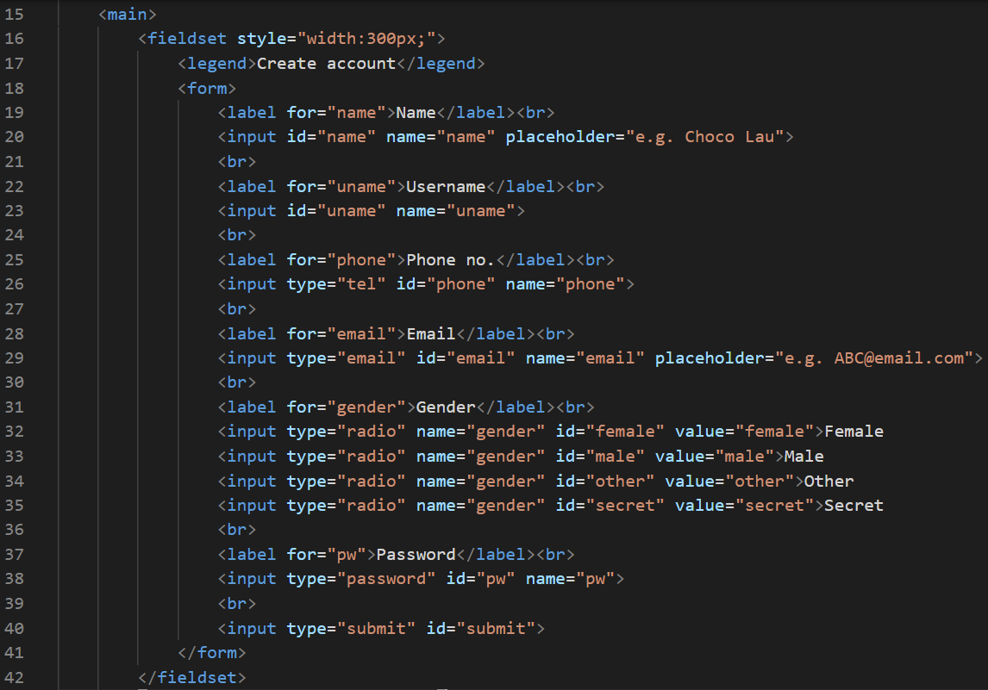
7.5 Exercise: Suggested answer
Notes:
Demonstrate the sample website

Slide 42
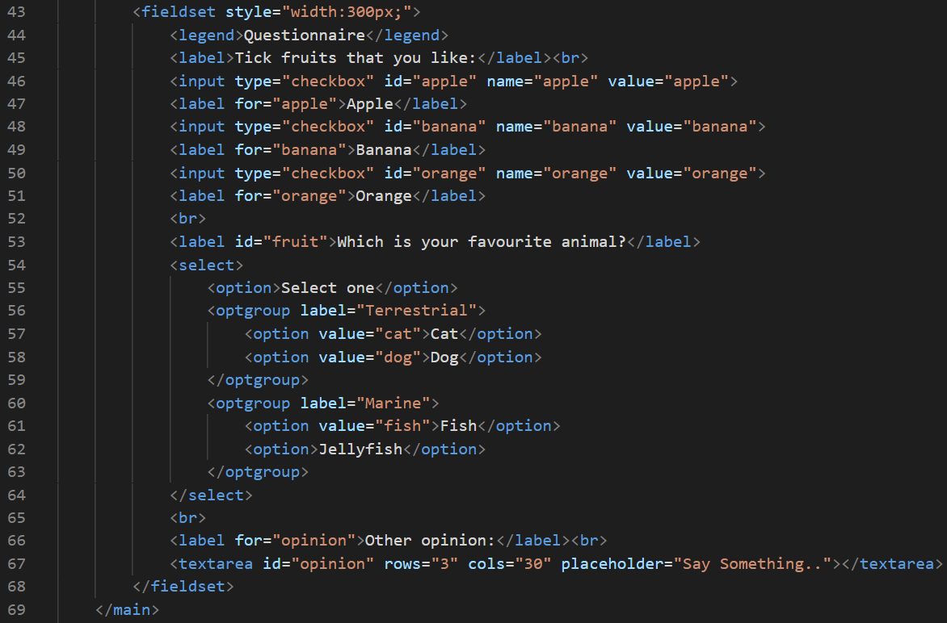
7.5 Exercise: Suggested answer
Notes:
Demonstrate the sample website

Slide 43
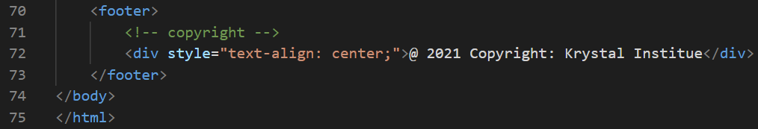
7.5 Exercise: Suggested answer
Notes:
Demonstrate the sample website

Slide 44
MC Quiz
10 minutes
https://www.online-stopwatch.com/countdown/

Slide 45
Reference
W3Schools (2021). HTML Tutorial [online] available from <https://www.w3schools.com/html/default.asp> [20 May 2021]

